Slide 1
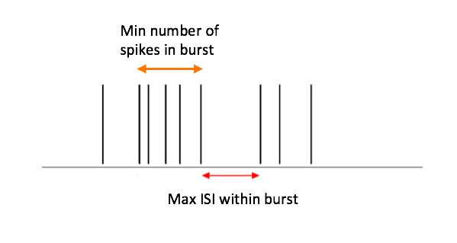
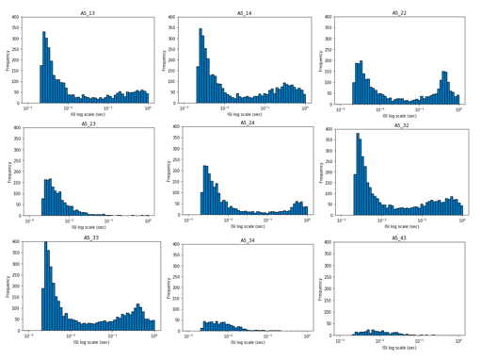
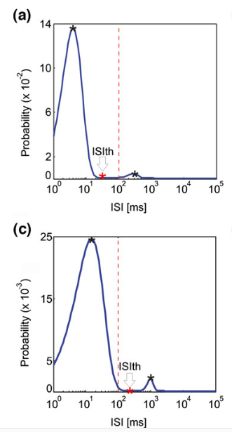
1) ISI Threshold: Two predefined thresholds – Min number of spikes allowed in burst, and min ISI between spikes in burst (Chiappalone et. al., 2005)
Generally; Min # spikes =5
Max ISI = 100ms
Doesn’t take into account intrinsic differences between cultures
2) Poisson Surprise: Assumes neurons fire according to a Poisson distribution based on the mean firing rate of the culture. And determines how improbable it is that a cluster of spikes fire together. Detects bursts as periods of deviation from an underlying Poisson distribution (Legéndy & Salcman, 1985)
Neural activity is not a Poisson process (Cateau & Rayes, 2006)
Probability of occurrence
3) Adaptive method: Adaptation of ISI threshold; sets thresholds based on underlying activity of the neural culture. (Pasquale et. al., 2010)
Number of Occurrences

Slide 2
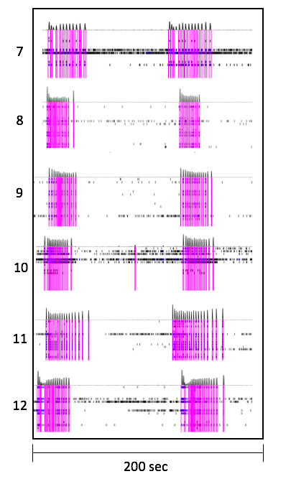
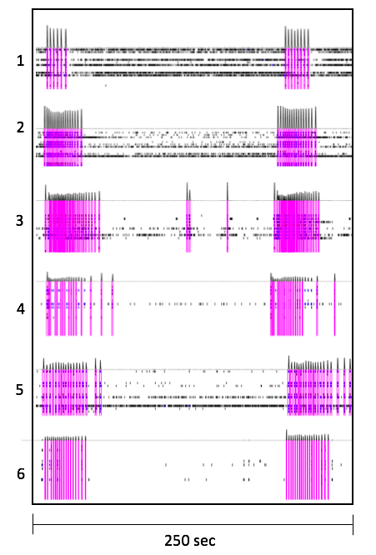
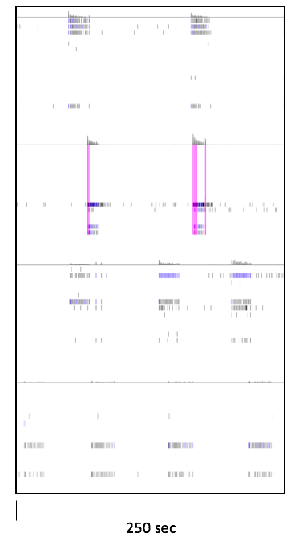
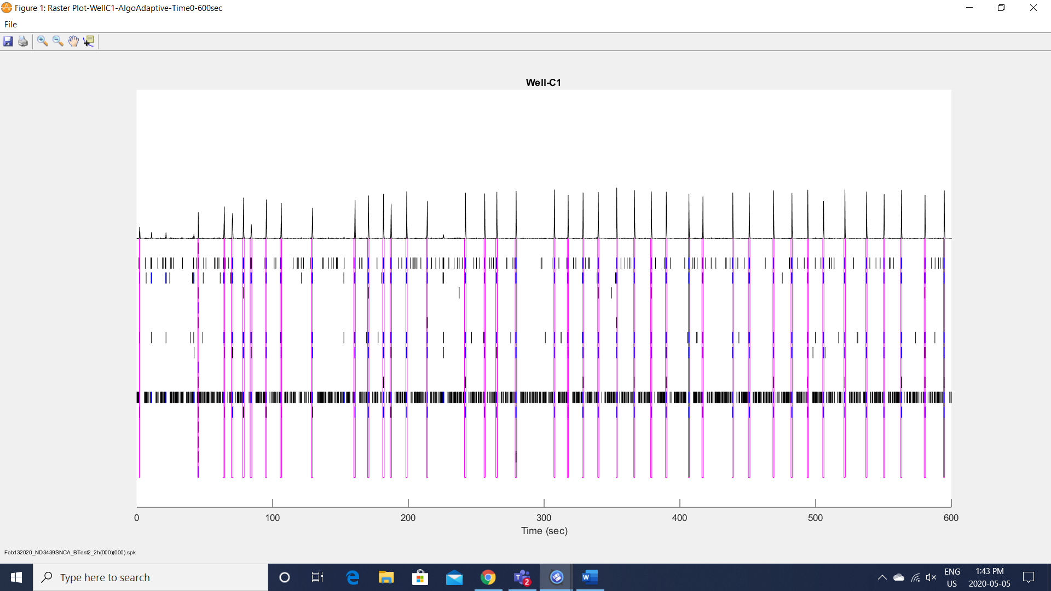
IBI = ~ 100 s
N = 8
IBI = ~ 150 s
N = 15
Nearly Super burst
N = 13
SB – Superburst
Chaotic bursting

Slide 3
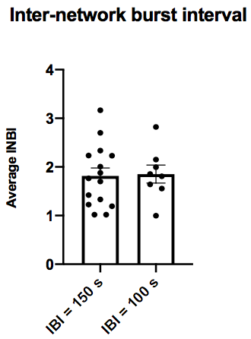
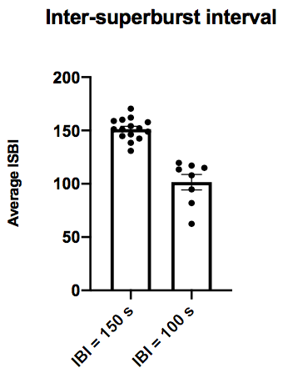
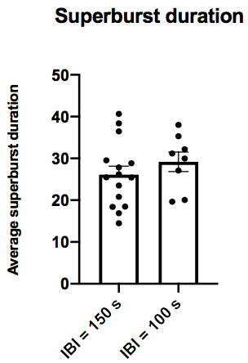
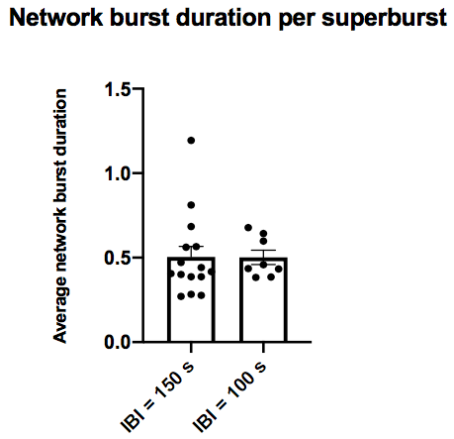
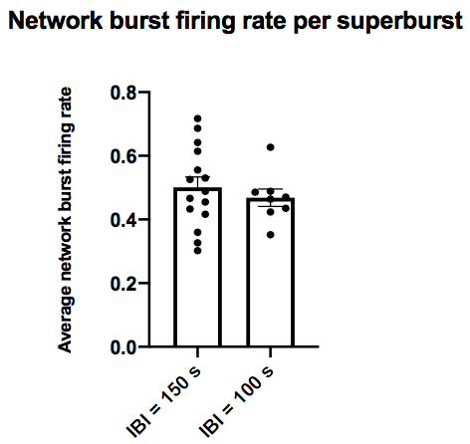
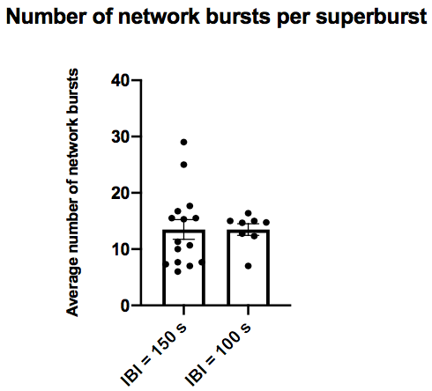

Slide 4
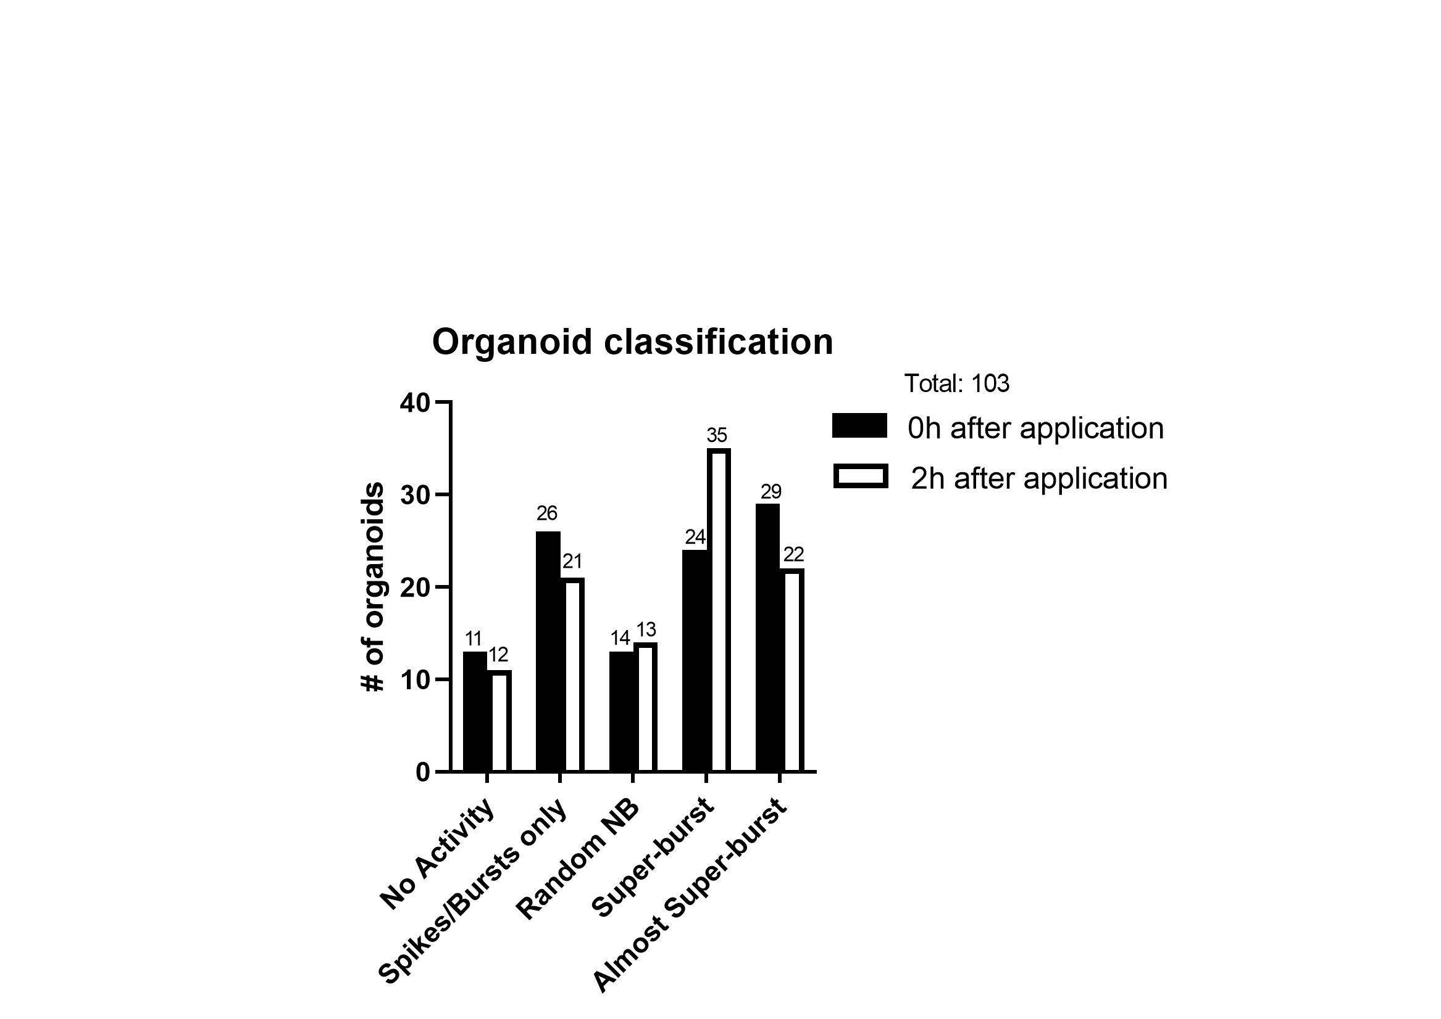
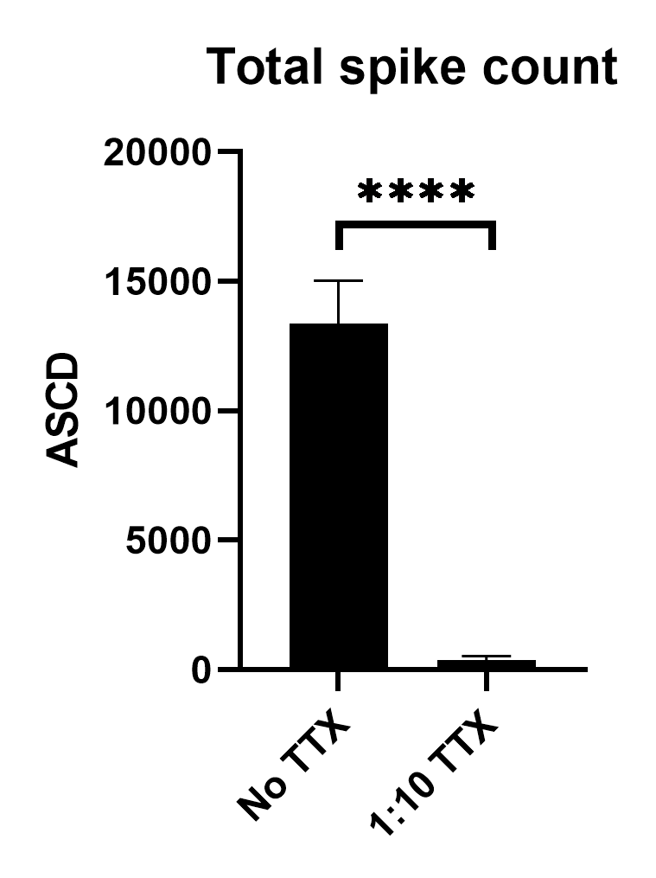
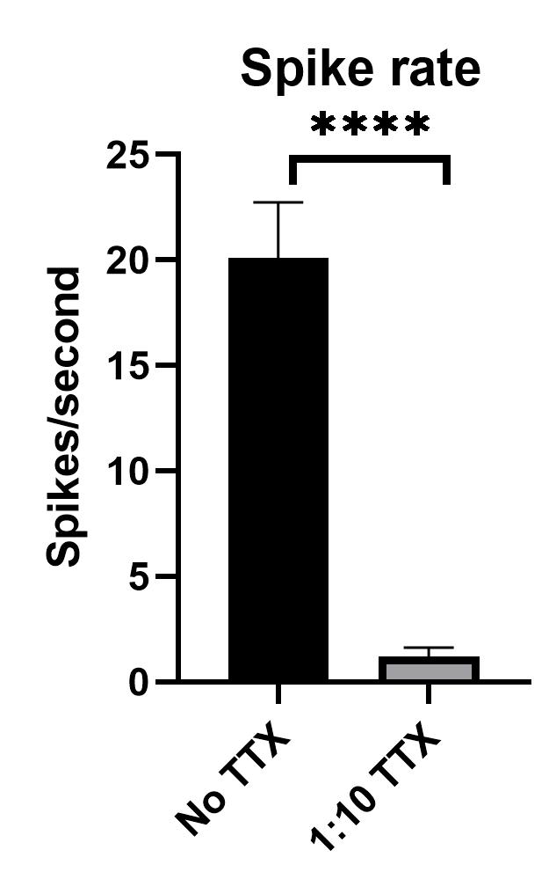
Superburst
N =
12
14
Almost superburst
11
13
No TTX
1:10 TTX

Slide 6
Organoid from batch 1
Organoid from batch 2

Slide 7
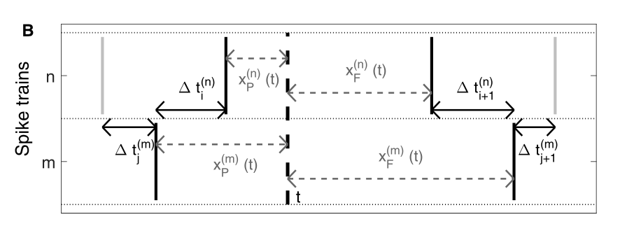
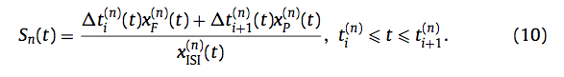
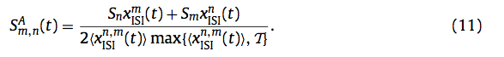
Spike train synchronization: SPIKE-distance Kreuz 2013
Cited by 167 papers
Compares the ISI for the two spike trains and how much the two spike trains differ in distance from t relative to their firing rate.
Difference profile is calculated for that time instant by averaging both spike time differences and normalizes it by the local or global firing rate set by T.
Normalizing by the local firing rate makes it sensitive to small deviations in synchrony (useful for patch clamp analysis)
Normalizing by the global firing rate makes small deviations in synchrony negligible (useful when analyzing bursts and network burst)

Slide 8
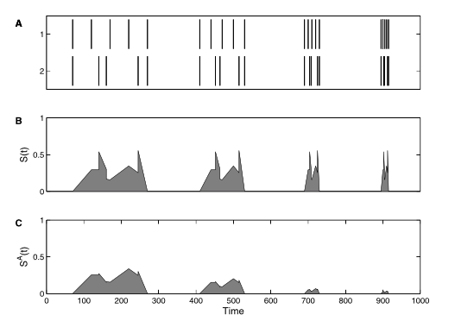
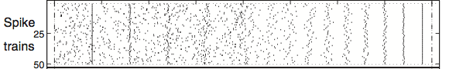
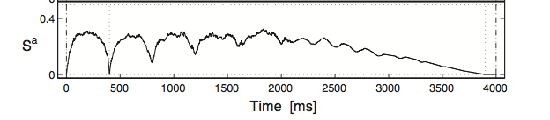
Local vs Global time scales
Data with multiple spike trains

Slide 9
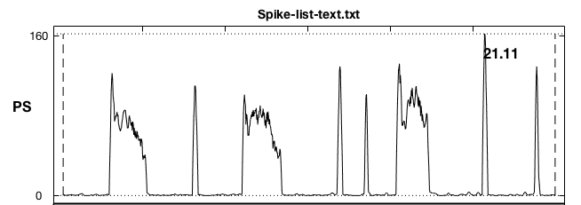
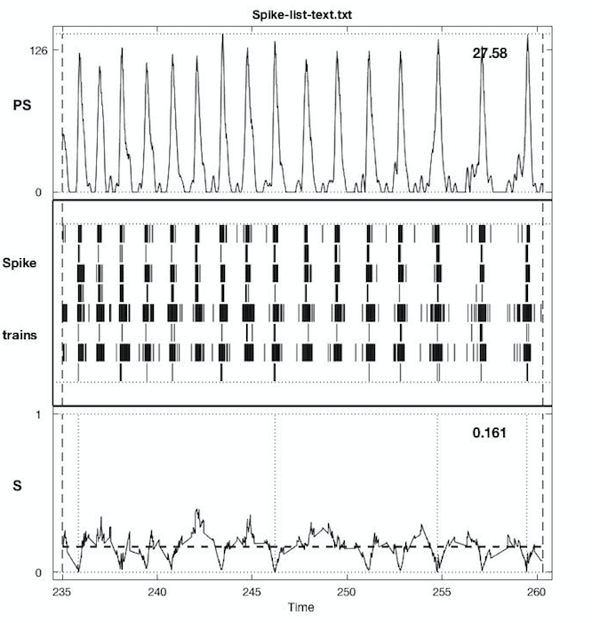
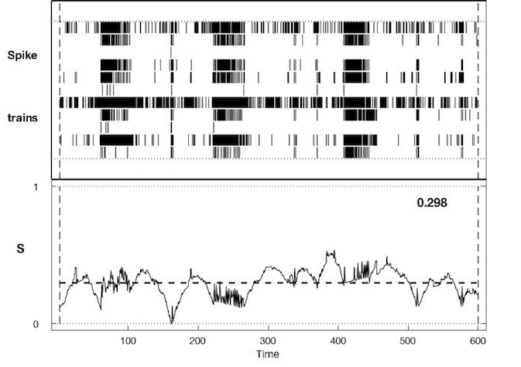
Example of well C3
Close up of a 25sec time frame

Slide 10
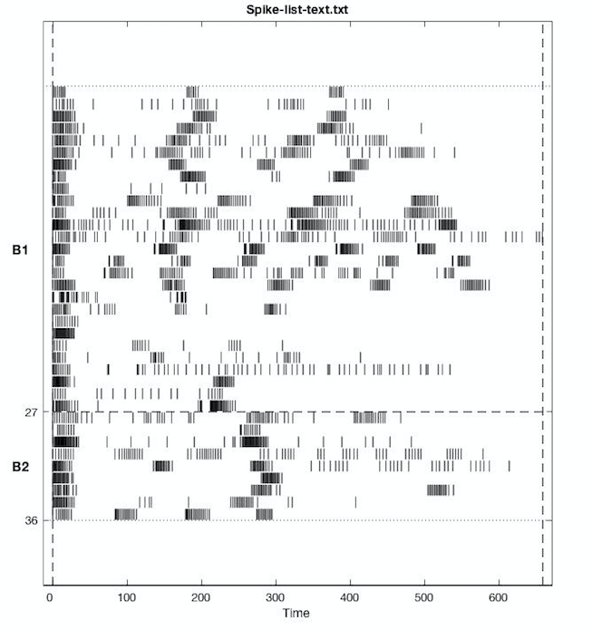
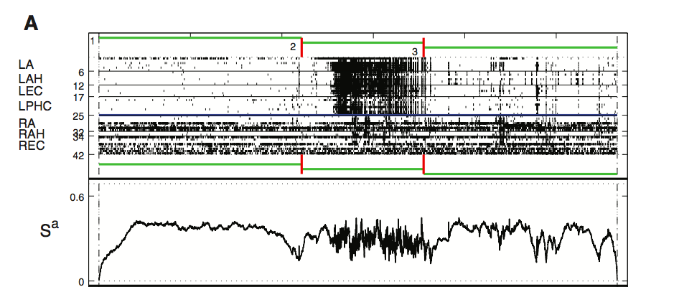
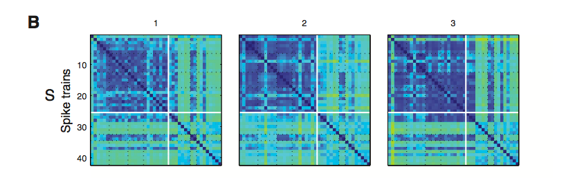
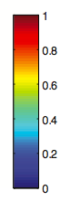
Network burst spike trains
Kreuz et al. 2013

Slide 11
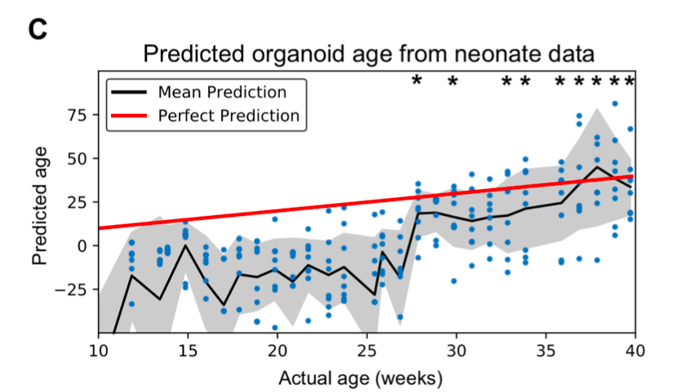
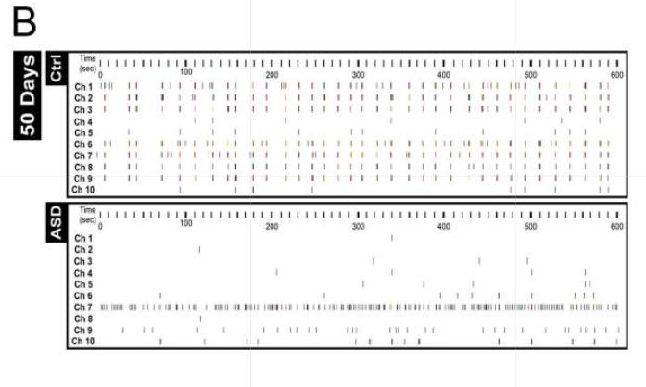
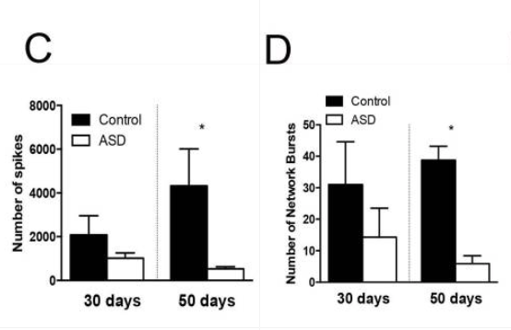
Modelling Neurodevelopment
Trujillo et. al 2019 show the emergence and development of oscillatory network dynamics similar to features found in the developing human brain.
We can track changes in network activity over time and observe how network activity can be impaired in developmental disorders such as autism.
This comparison can be done across treatments throughout time.
Trujillo et al. 2019
Marchetto et al. 2017
Extracted from presentation
Notes:
In 2019 Trujillo and colleagues showed that you could model neurodevelopment in cerebral organoids by comparing the emergent osccilatory activity seen in infant brains with the development and emergence of this activity in organoids.
By recording neural activity and network properties from organoids over long periods of time using the MEA, he was able to show the emergence of oscillatory activity in organoids that resembles patterns of emergence found in human infants. So here he was then able to get a pattern recognition algorithm to figure out the age of the baby by looking at the activity of organoids at that age and he shows that after 28 weeks of organoid development the activity was significantly similar to what the activity would look like in the human brain, represented by these black stars.
That is an example of examining healthy neural development, but we can also track changes in neural network activity over time in neurodevelopmental disorders such as autism.
So here we see the comparison of a healthy neural culture to a neural culture with mutations involved in autism at 50 days, and they show a large disruptance in network formation in the ASD culture. And these types of observations can be done over long periods of time, as we can see here there is no significant difference in network activity in both the total number of spikes and number of network bursts at 30 days, but this difference starts to emerge at 50 days.
Although its not shown here, of course you would be able to make these kinds of comparisons over even longer periods of time and across different treatments, lets say if you were testing the effects of certain phatmaceuticals.
therefore the organoid is a good model to study neurodevelopmental disorders such as autism .

Slide 12
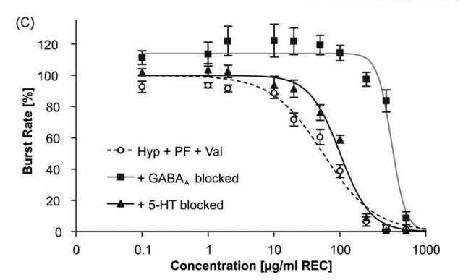
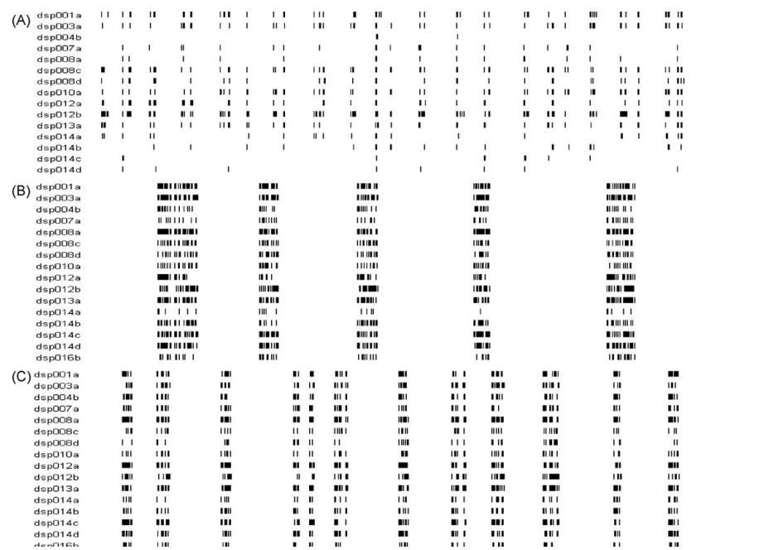
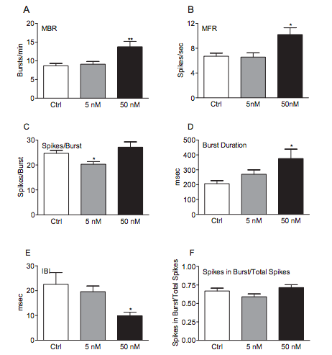
Neurotoxicity and drug screening tests
Comparison of neural activity
Untreated
Clonazepam
Extracted from presentation
Johnstone et al. 2010
Notes:
So heres another example of how we can track the effects of drugs, this graph is showing 15 different neurons in the frontal cortex that were recorded before treatment and after treatment of carbamazepine and clonazepam, which are both anticonvulsants and are used to treat seizures.
And we can see the change in the pattern of network activity, and from this you can extract a multitude of parameters such as the mean firing rate, bursting rate, number of spikes within bursts, burst duration and compare these across concentrations, or treatments.
Or another thing you can do it create a dose response curve like this, this curve is not for the same drugs here but this can show you the change with increasing concentrations but also across treatments, so you can see how drugs may affect neurons with different treatments such as blocked GABA receptors or serotonin receptors.

Slide 13
Extracting parameters Measure of synchronization (Kreuz, 2013)
Cited by 167 papers
Compares the ISI between spikes as well as the timing between spikes in two different spike trains.
Difference index is calculated for individual time instants by measuring the difference in spike rate and in spike timing.
Kreuz, 2013
Extracted from presentation
Notes:
Another parameter that is particularly useful in measuring changes across network activity is the spike train synchronization measure.
This was created my Thomas Kreuz in 2013, and has been used in many papers as a measuring of identifying the similarity index between two or more spike trains.
So Thomas Kreuz created this open source software, and he has the code available on Matlab, Python, and C++ if anyone is interested in checking it out.
But what this measure does is it set up time instants across the entire spike train, represented by this dashed line, and for each time instant the two closest spikes in each spike train, and itll compare the ISI for each spike train, so how fast that spike train is firing, as well as how far away each corresponding spike it from each other, so how much this spike deviates from its corresponding spike in the other train.
And it finds the synchronization index for each time instant then averages all time instants across the train to find the synchronization index for the entire train.
So similarity indexes closer to 0 indicate perfect synchronization between spike trains, and indexes closer to 1 indicate no synchronization
And so here is an example he shows in his paper of the synchronization profile for 50 spike trains with a lot of background noise in the first half of recording and little background noise in the second half.
So during these periods of background noise we see high dissimilarity measure but as we get synchronization between the spike trains the dissimilarity measure drops down indicating high levels of similary for this time instant.
And then as background noise subsides, and we get more synchronized network activity the over all measure of dissimilarity decreases

Slide 14
Future questions
Are organoids a good model to study disorders or patient specific drug screens?
Are they reliable and reproducible (inter-batch variability, intra-batch variability, variability between cell lines, variability in response to drugs)
What causes the emergent oscillatory activity in Parkinson’s?
Can these changes be slowed down/interfered with? What’s the cellular mechanism that causes this (2D cultures)?
Extracted from presentation
Notes:
And so some future questions that could be asked using this technology is looking at if organoids are a good model to study disorders or for doing patient specific drug screens. In order for them to be good models they should provide us with reliable and reproducible results, so we would have to look at thinks like whats the inter and intra batch variability in responses to drugs or rate of development, or progression of disease pathology. And it it can be used to measure variability between cell line or between genotypes too.
We can also look at this emergent oscillatory activity with the progression of parkinsons, we can look at whats causing this to happen and if the process can be slowed down or interfered with.

Slide 15
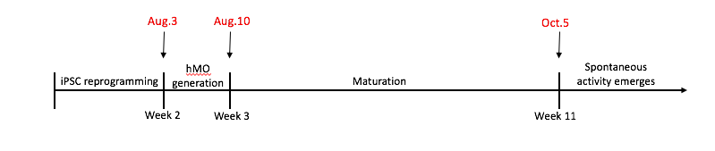
27/07/2020 update
Cell lines:
AJD002-3 Male 44 yrs (~150 hMO’s)
AIW002-02 Male 37 yrs (~150 hMO’s)
AIW001-02 Female 48 yrs (~150 hMO’s)
Timeline:

Slide 16
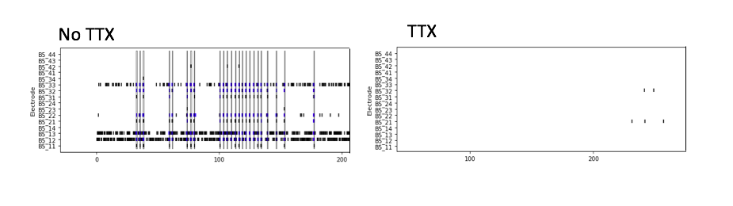
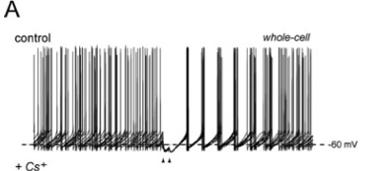
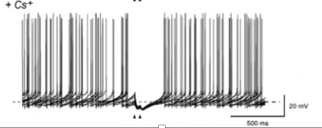
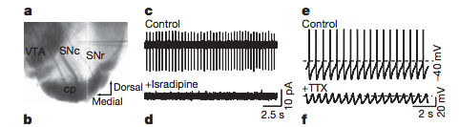
Record 37 hMOs
Record 37 hMOs
Record 37 hMOs
Record 37 hMOs
Maturation
2 months
4 months
6 months
8 months
Every 2 months record 37 organoids from each cell line;
20 mins baseline activity
10 mins activity following each drug application
Drug application:
1. TTX (To validate activity)
3. Cs+ (HCN channel antagonist)
2. Isradipine (L-type calcium channel antagonist)
Chan et al. 2004
4.
Picrotoxin (GABA antagonist)
NMDA antagonists
D1/D2 receptor agonist or antagonist
Surmeier et al. 2007
Notes:
Isradipine blocks L typye calcium channels responsible for autonomous pacemaking activity in SNc, the decrease of dopamine input to striatum is what is thought to cause rhythmic activity in basal ganglia by connecting the different nuclei. So isradipine should show sig decrease in activity in control organoids but not in PD organoids where the input to basal ganglia is already severed and synchronous activity emerged.
HCN channels play a role in pacemaking of GP neurons but not STN or SNc neurons, so blocking them may show a significant decrease in synchronized activity in PD organoids but not much change in controls organoids. Disruptions in striatal gabaergic input into the GP may trigger the emergent synchronous activity seen in GP by causing over activation of HCN neurons which control autonomous pacemaking activity in GP neurons
NMDA receptors seems to regulate bursting activity in SN
Striatal input into the Gpi is facilitated by D1 receptors and input into the indirect path is facilitated by D2 receptors. In PD the spike rate of Gpi neurons increase and Gpe neurons decrease, so dopamine depletion in the striatum leads to reduced inhibition in the direct pathway

Slide 17
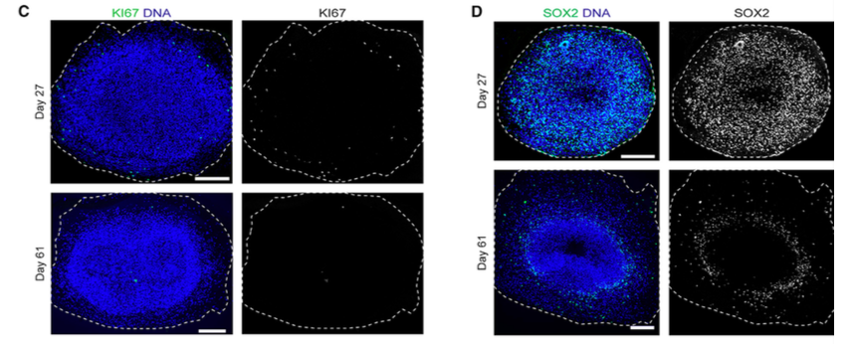
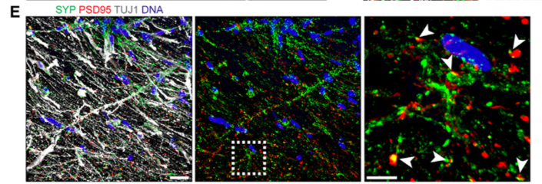
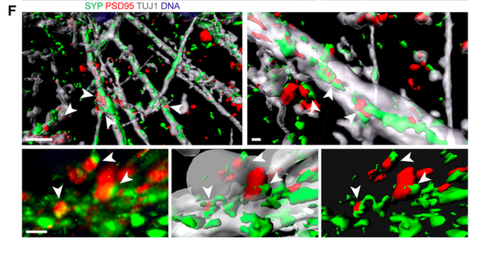
Histology
Ki-67/SOX2 (proliferation and progenitor cells)
PSD-95 (dendritic spines)
Tuj1 (immature neurons)
Map2 (mature neurons)
p-Syn
pUb
Monzel et al. 2017
Notes:
When introducing oscialltion analysis, talk about how it will be useful to look at the effects of dopamine depletion on basal ganglia activity, it seems that Da depletion causes low frequency oscillatory activity

Slide 18
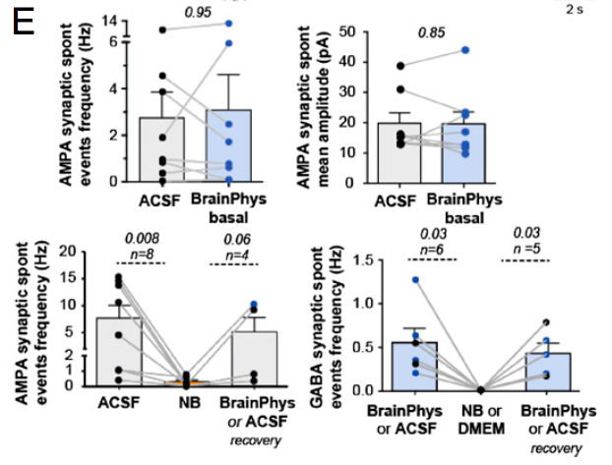
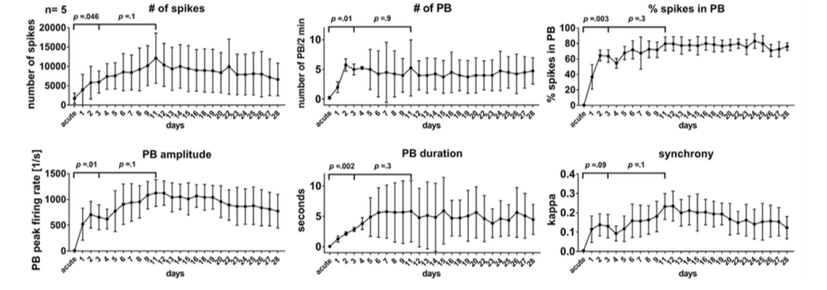
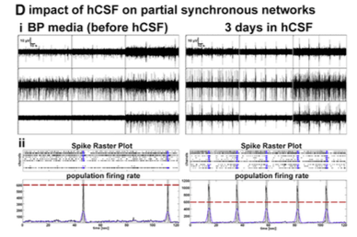
Data update: August 24th 2020
ACSF test
hCSF promotes neural activity in 3D neural aggregates
Neurobasal media suppresses neural activity in 2D cultures
Izsak et al. 2020
Bardy et al. 2015
ACSF composition pH 7.3
Adjusted to match salt concentration and osmolarity of DMEM and brainphys
Replace neurobasal with ACSF
Incubate at 5% CO2, 37°C for 1 hour
Record for 10 mins
121 mM NaCl
4.2 mM KCl
1.1 mM CaCl
1 mM MgSO4
29 mM NaHCO3
0.45 mM NaH2PO4-H2O
20 mM Glucose

Slide 19
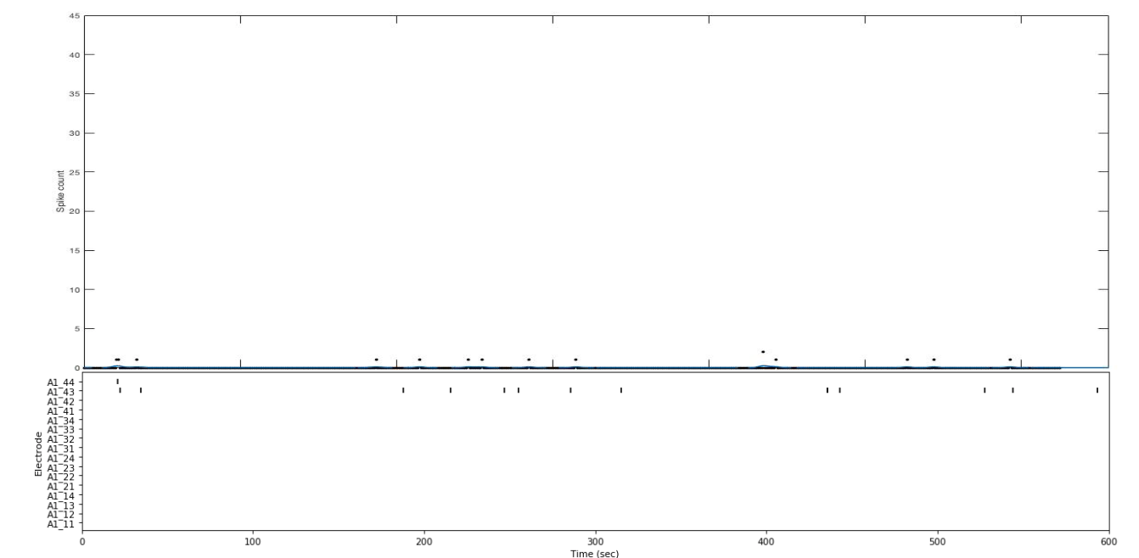
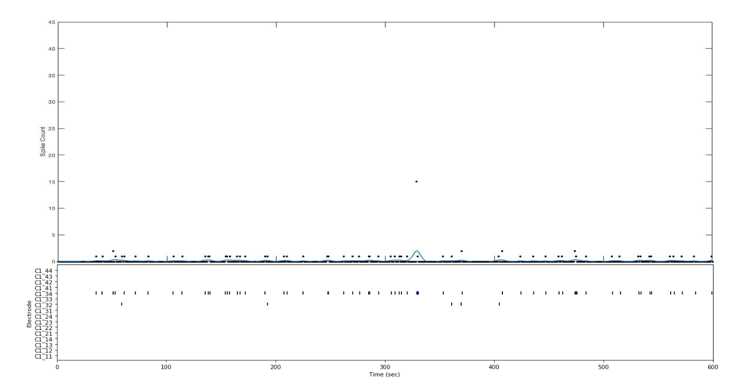
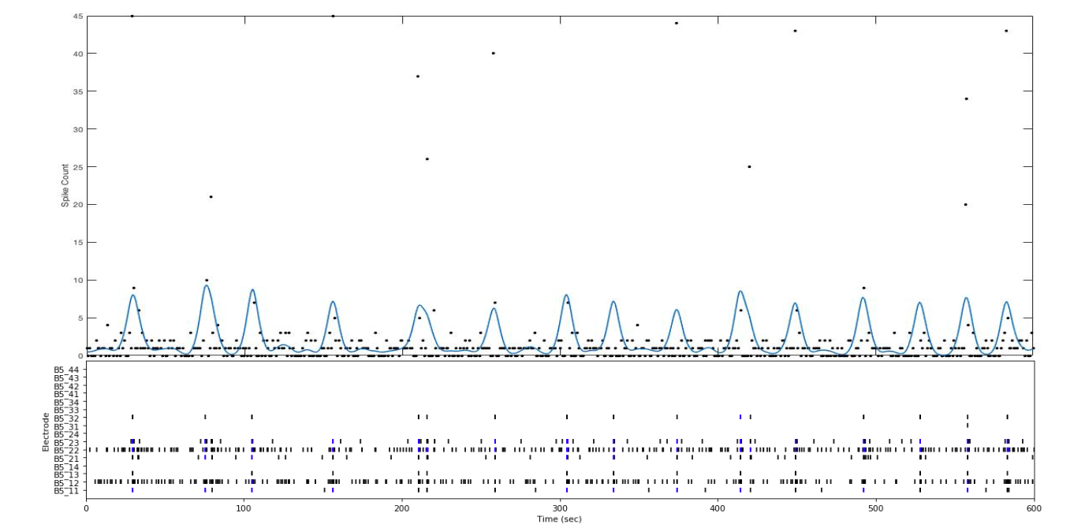
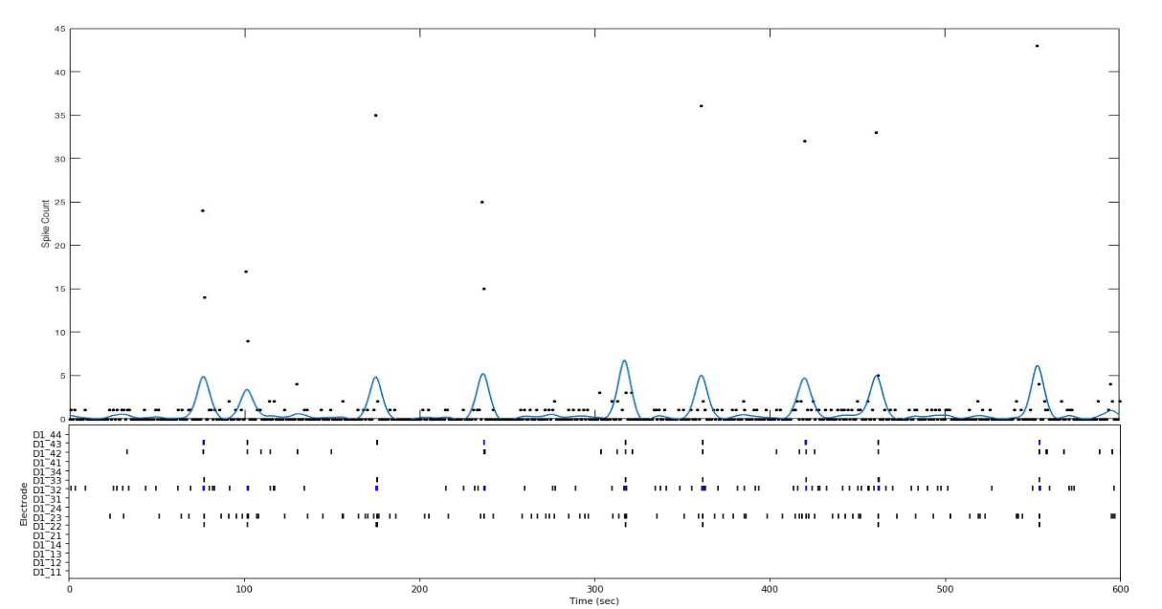
AST23 4KO
AIW002-02
~50 days
~50 days
N=6
N=4
ACSF
N=6
N=4
Neural basal media

Slide 20
n = 6
n = 4
n = 6
n = 4
n = 4
n = 4
n = 6
n = 6
n = 6
n = 4
n = 6
n = 4

Slide 21


Axion Biosystems long term culture protocol
Data update: Nov 2th 2020
Cell line: AIW002-02
Age: 90-98 days
Day 0:
→ 42 out of 48 organoids adhered to electrodes (87%)

Slide 22
→ No difference in recorded activity between ACSF and basal media

Slide 23
Validation of activity
Recorded baseline activity for 10 mins
Added 1uM PTX, let incubate for 30 mins
Changed media and added 1uM of TTX, let incubate for 30 mins
***
***
***

Slide 24

Measures of synchrony
Synchrony between electrodes is a product of network bursts
Electrode
25 sec

Slide 25


Fourier transformation to detect frequency band
Beta oscillations emerge in mouse models following DA depletion and cortical activation
Mallet et.al 2008

Slide 26


WT organoids show oscillations in both delta and beta bands
Renner et.al 2020

Slide 27
Recording 1 – Batch 2

